Slide 1
Entity-Relationship Diagrams (ERD)

Slide 2
Comparisons What are the differences between DFD and ERD
Data Flow Diagram
graphical representation of the data in motion within a system. It describes the process
sow how data elements (that compose a data flow) are processed and passed on to subsequent processes or a store.
Entity Relationship
is a graphical representation of the data in rest within a system
shows how the data elements are logically grouped in entities
https://www.quora.com/What-are-the-differences-between-DFDS-and-ERDS

Slide 3
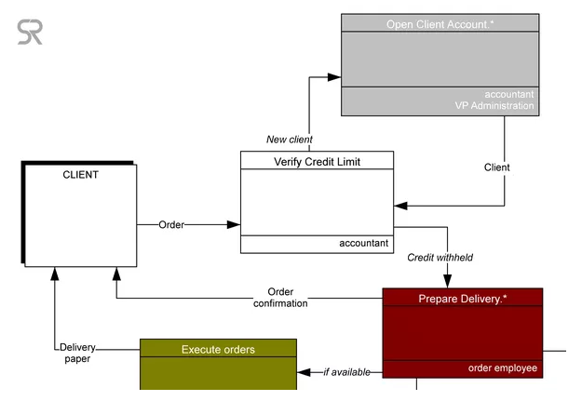
Data Flow Diagram
https://www.quora.com/What-are-the-differences-between-DFDS-and-ERDS

Slide 4
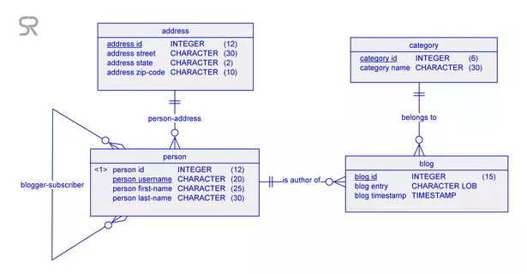
Entity –Relationship Diagram
https://www.quora.com/What-are-the-differences-between-DFDS-and-ERDS

Slide 5
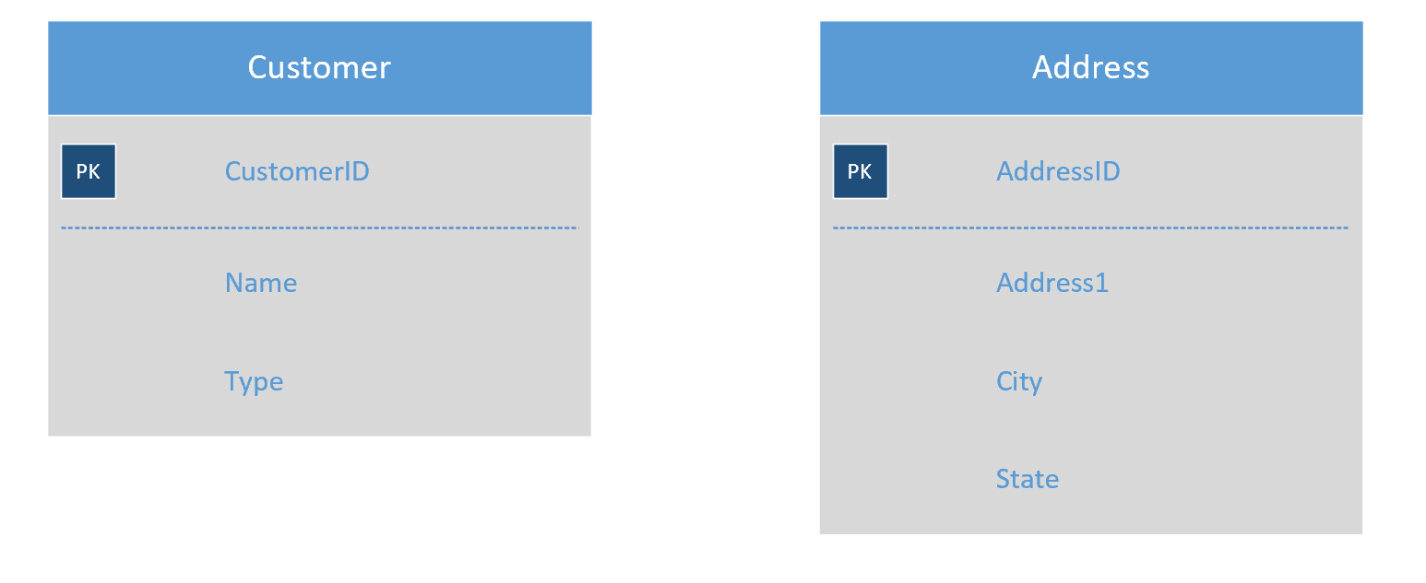
ER Relationships

Slide 6
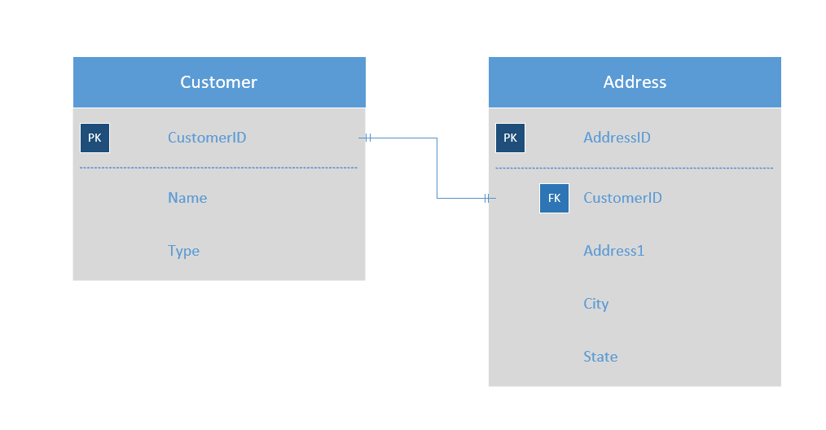
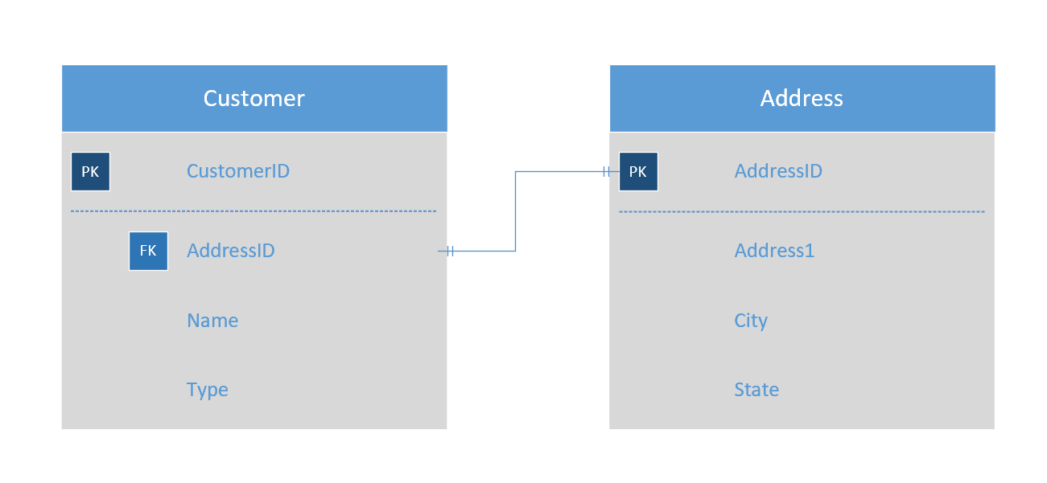

Slide 7
Naming Convention
Entities
Do not add unnecessary words
Example of BAD entity names: CustomerInfo, CustomerList, CustomerData
Good example: Customer, Order, Product
Entity names should be descriptive
Attributes:
Do Not name every PK as “ID”
Attribute names should be descriptive
Example of Good attribute names: FirstName, Last Name
Choose a convention and stick with it.
Camel case example: ProductCategory
“-” example Product_Category

Slide 8
Which is a better attribute?
Date of Birth vs Age?

